Slide 1
COMP1451: Introduction to Software Development II
Lesson 1

Slide 2
Learning Outcomes: Lesson 1
Course Introduction
Review: concepts from COMP 1409
Introduction to Eclipse IDE
Default/package-private visibility
Create our own packages
public static void main() method
Commandline arguments

Slide 3
Review: concepts from COMP 1409
Arrays
Loops
ArrayLists
Iterators
Composition
Overloading
static
Etc…

Slide 4
Introduction to Eclipse IDE
BlueJ is a tool for beginning students.
Eclipse is one of many tools that are used by professional Java developers.
Download the “Eclipse IDE for Java developers” free from eclipse.org.

Slide 5
Default/package-private visibility
The private access modifier limits access to that class only.
The public access modifier allows access by any class.
Clearly, public instance variables are a bad idea.
There are more access modifiers available to us.
If we do not specify any access modifier, it becomes “package-private”.
Package-private means the variable or method or class is accessible to its own class, and also to any other class in the same package.

Slide 6
Default/package-private visibility
package ca.bcit.comp1451.lesson1;
public class Test {
int x; // no visibility modifier
}
package ca.bcit.comp1451.lesson1;
public class Test2 {
public Test2(){
Test t = new Test();
System.out.println(t.x); // accessible!
}
}

Slide 7
Create our own packages
Packages encompass related classes.
From the official Java documentation:
“A package is a namespace that organizes a set of related classes and interfaces. Conceptually you can think of packages as being similar to different folders on your computer. You might keep HTML pages in one folder, images in another, and scripts or applications in yet another. Because software written in the Java programming language can be composed of hundreds or thousands of individual classes, it makes sense to keep things organized by placing related classes and interfaces into packages.”

Slide 8
Create our own packages
From the official Java documentation:
“With programmers worldwide writing classes and interfaces using the Java programming language, it is likely that many programmers will use the same name for different types. For instance, you can define a Rectangle class when there is already a Rectangle class in the java.awt package. Still, the compiler allows both classes to have the same name if they are in different packages. The fully qualified name of each Rectangle class includes the package name. That is, the fully qualified name of the Rectangle class in the graphics package is graphics.Rectangle, and the fully qualified name of the Rectangle class in the java.awt package is java.awt.Rectangle.
This works well unless two independent programmers use the same name for their packages. What prevents this problem? Convention.
Naming Conventions
Package names are written in all lower case to avoid conflict with the names of classes or interfaces.
Companies use their reversed Internet domain name to begin their package names—for example, com.example.mypackage for a package named mypackage created by a programmer at example.com.
Name collisions that occur within a single company need to be handled by convention within that company, perhaps by including the region or the project name after the company name (for example, com.example.region.mypackage).”

Slide 9
public static void main() method
From the official Java documentation:
In the Java programming language, every application must contain a main method whose signature is:
public static void main(String[] args)
The modifiers public and static can be written in either order (public static or static public), but the convention is to use public static as shown above. You can name the argument anything you want, but most programmers choose "args" or "argv".
The main method is similar to the main function in C and C++; it's the entry point for your application and will subsequently invoke all the other methods required by your program.
The main method accepts a single argument: an array of elements of type String.
public static void main(String[] args)
This array is the mechanism through which the runtime system passes information to your application. For example:
java MyApp arg1 arg2
Each string in the array is called a command-line argument. Command-line arguments let users affect the operation of the application without recompiling it.

Slide 10
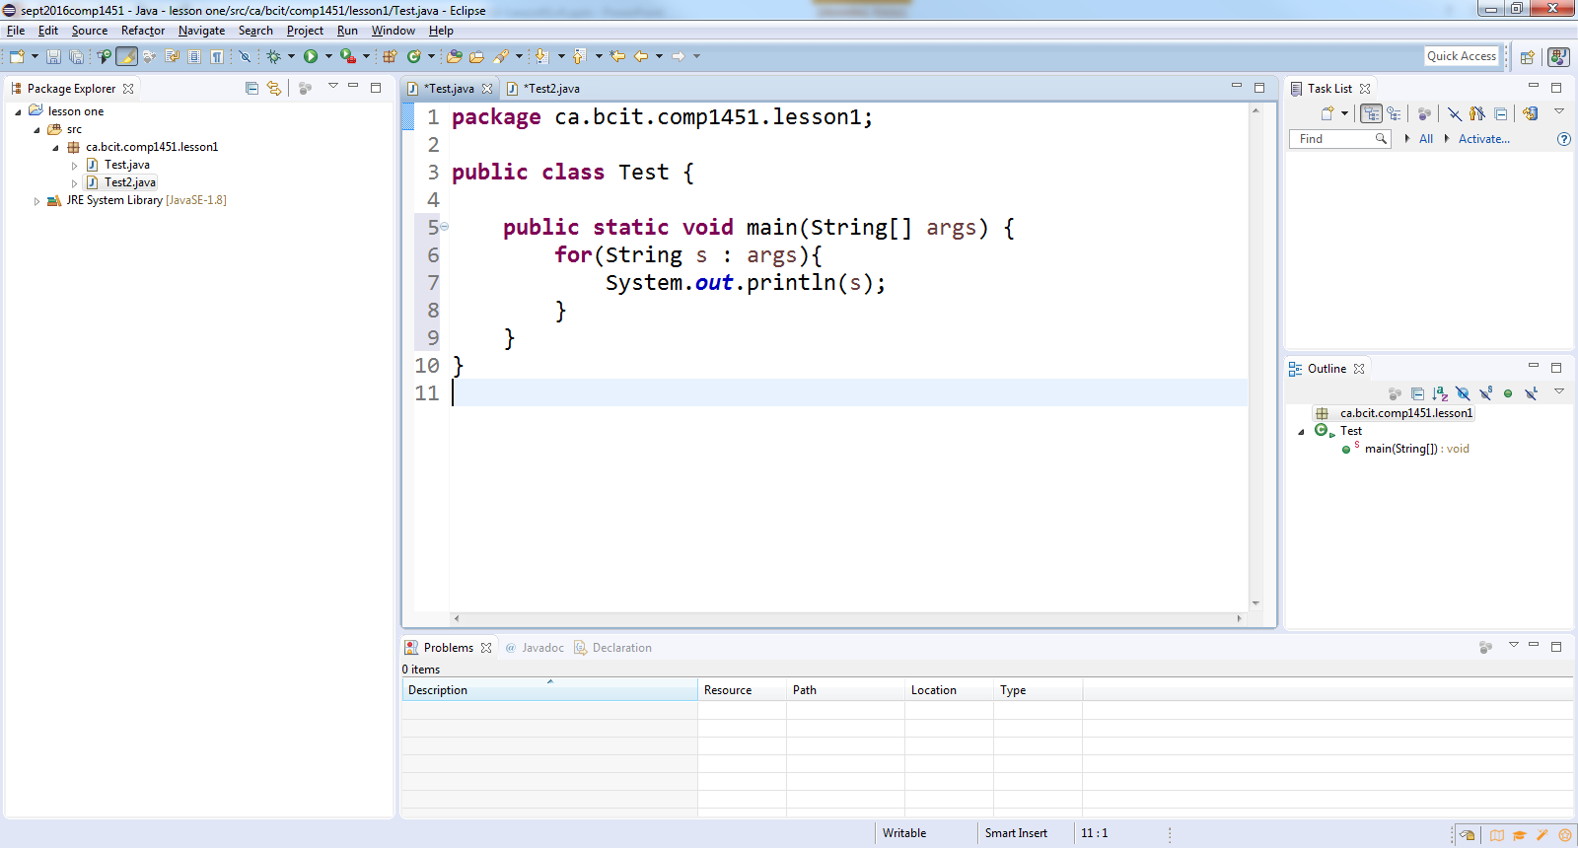
Commandline arguments

Slide 11
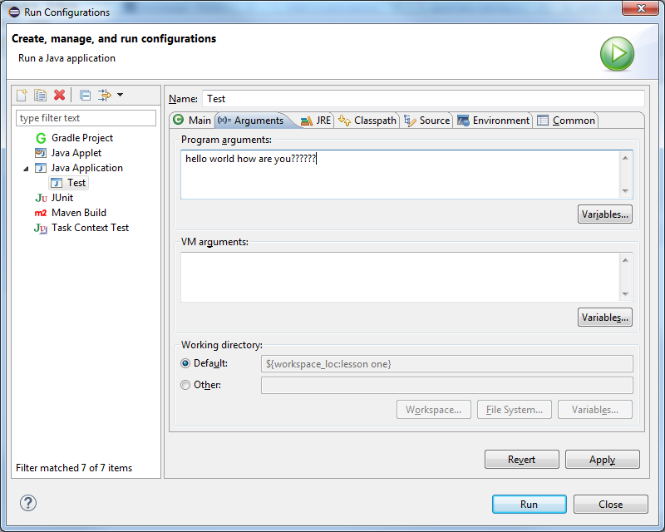
Commandline arguments

Slide 12
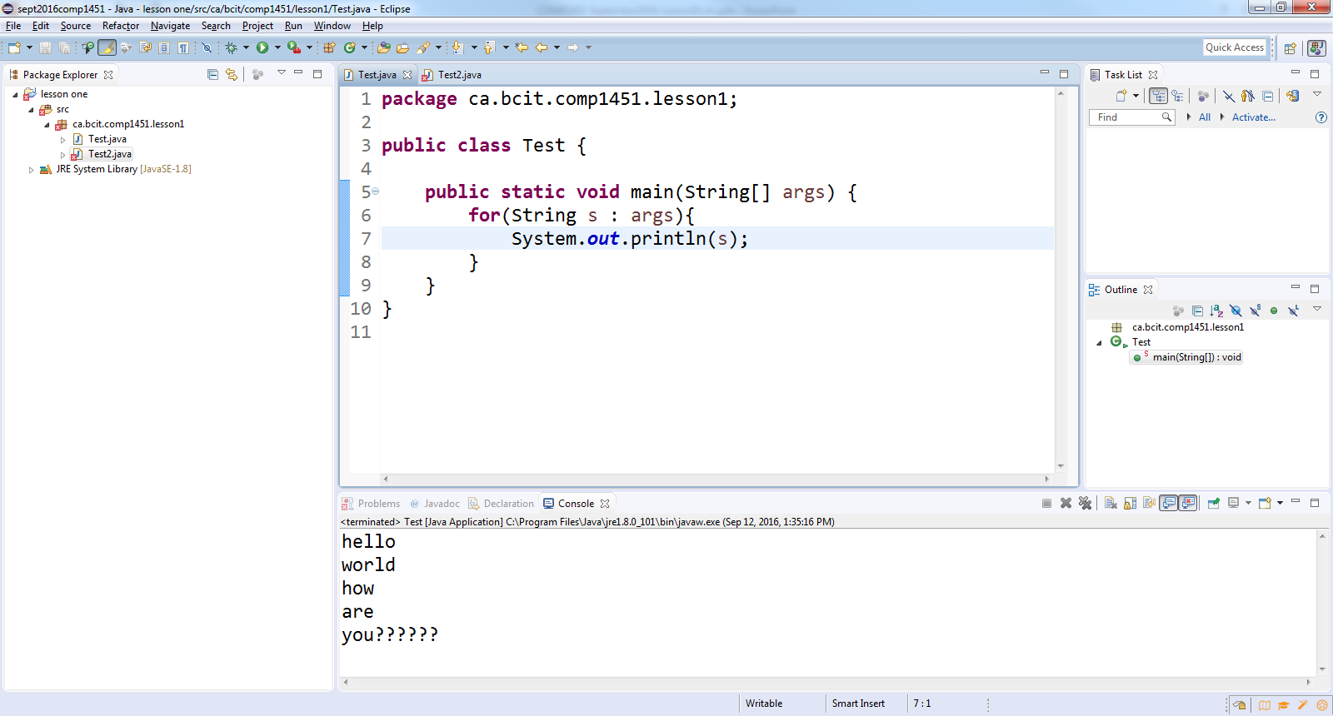
Commandline arguments

